Slide 1
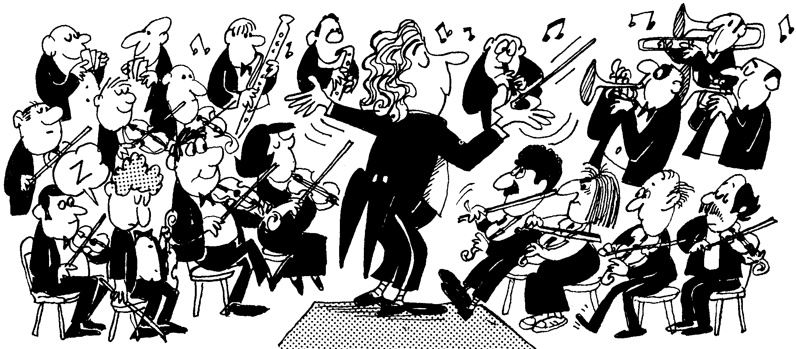
OCR GCSE Music
Area of Study 2
Concerto Through Time
DNA: Answer the following:
What are the dates of the Baroque period?
Name a famous composer of the Baroque period?
Name an instrument you can remember from the orchestra at that time
Lesson 2 – Baroque

Slide 2
Lesson 2
Learning objectives:
To analyse the Baroque orchestra.
To recognise some key features and sounds of the concerto grosso.
Progress indicators:
Good | Outstanding
Identify key vocabulary and complete sentences in relation to this musical period. Listen to an example and pick out basic features such as instruments and dynamics. | Able to add words to complete the given information with very little resources. Use more complex vocabulary and answer questions regarding specific techniques.

Slide 3
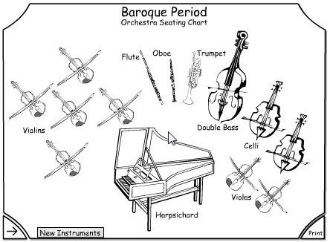
Recap of a Baroque orchestra
The Basso Continuo is an accompaniment.
The Harpsichord plays chords and the left hand of the harpsichord plays the bass line, along with the cello.
Learning objectives:
To analyse the Baroque orchestra.
To recognise some key features and sounds of the concerto grosso.

Slide 4
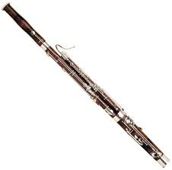

Other instruments sometimes used in Baroque
Recorder
Bassoon
Learning objectives:
To analyse the Baroque orchestra.
To recognise some key features and sounds of the concerto grosso.

Slide 5
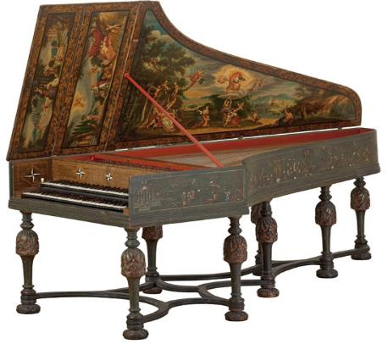
Harpsichord
The Harpsichord was a popular keyboard instrument used in Baroque period. The piano hadn’t yet been invented.
The harpsichord could only play short notes due to the way the strings were hit.
It also couldn’t change dynamic gradually.
Terraced dynamics.
Learning objectives:
To analyse the Baroque orchestra.
To recognise some key features and sounds of the concerto grosso.

Slide 6
What does Concerto Grosso mean?
A concerto is typically a piece of music for a solo instrument and an orchestra. However in the Baroque period, they would write a concerto for a group of ‘solo instruments’ with an orchestra as accompaniment.
Concerto Grosso literally translates to ‘Big Concerto’
Learning objectives:
To analyse the Baroque orchestra.
To recognise some key features and sounds of the concerto grosso.

Slide 7
Basic features of the Baroque Concerto Grosso
Music had long flowing melodies
Polyphonic or contrapuntal writing where melodies interweaved with one another as well as homophonic sections
Contrasts between the solo passages, accompanied by the continuo, followed by tutti (everyone plays)
Contrast between loud and soft dynamics (terraced dynamics)
Sequences
Lots of ornamentation – trills, turns and mordents
Three movements
The small group of soloists is called a concertino
The larger group is called the ripieno or tutti
Learning objectives:
To analyse the Baroque orchestra.
To recognise some key features and sounds of the concerto grosso.

Slide 8
Task 1: Match the key terms to their definitions
Key term
Polyphonic texture
Homophonic texture
Solo
Tutti
Terraced dynamics
Sequence
Ornamentation
Support:
Use the internet to research each of the terms and help you match it to the definition.
Stretch: Use your prior musical knowledge to help you complete this task rather than the internet.
Learning objectives:
To analyse the Baroque orchestra.
To recognise some key features and sounds of the concerto grosso.

Slide 9
Task 1: Answers
Key term | Definition
Polyphonic texture | Not one clear melody, interweaving parts
Homophonic texture | Accompaniment moves at the same time
Solo | On their own
Tutti | Everyone playing
Terraced dynamics | Loud passages followed by quiet passages
Sequence | A passage of music repeated higher or lower in pitch
Ornamentation | Decoration to the melody
Learning objectives:
To analyse the Baroque orchestra.
To recognise some key features and sounds of the concerto grosso.

Slide 10
Task 2: Fill in the blanks!
Use computers to do some further research about the Baroque style and Concerto Grosso.
Find the key words to fill in the blanks on the sheet.
Progress indicators:
Good | Outstanding
Identify key vocabulary and complete sentences in relation to this musical period. | Able to add words to complete the given information with very little resources.
Learning objectives:
To analyse the Baroque orchestra.
To recognise some key features and sounds of the concerto grosso.

Slide 11

Task 3: Listening
Listen to the first 1 minute and 44 seconds of The Brandenburg Concerto Number 2.
Complete the exam style listening questions on your sheet.
Progress indicators:
Good | Outstanding
Listen to an example and pick out basic features such as instruments and dynamics. | Use more complex vocabulary and answer questions regarding specific techniques.
Learning objectives:
To analyse the Baroque orchestra.
To recognise some key features and sounds of the concerto grosso.

Slide 12
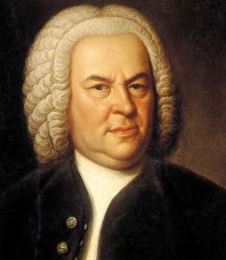
Homework
Create a fact file about the famous Baroque composer Bach.
Include information about his life with particular focus on his ‘musical journey’.
Add information about some of his most famous works and his compositional style.
Learning objectives:
To analyse the Baroque orchestra.
To recognise some key features and sounds of the concerto grosso.

