Slide 2
LO4 - Know about the role of the national governing bodies in sport

Slide 3
DNA
What do all these pictures represent ?

Slide 4
What is a national governing body?
Governing bodies of sport are typically independent, self-appointed organisations that govern their sport. Examples of this can include disciplinary action for rule infractions and deciding on rule changes

Slide 5
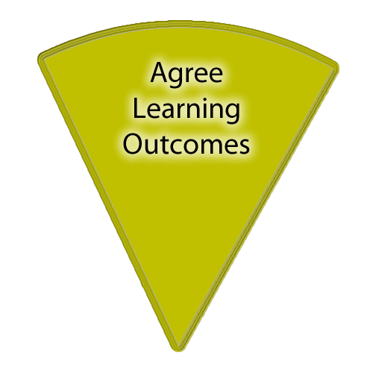
Progress Indicators
PLANNERS OUT!
Good Progress | Outstanding Progress
Define what a National Governing Body is. | List at least five different National Governing Bodies and the sports that they represent.
Explain the different roles that National Governing Bodies play in relation to their sports. | Analyse ‘promotion’ and ‘development’.
Accelerated Learning | Assessment for Learning | Collaborative Learning | Effective use of ICT | Thinking for Learning

Slide 6
What is sports England ?

Slide 8
What NGBs do in sport:
Promotion
Development
Infrastructure
Funding
support
Policies and initiatives

Slide 9
LO4 National Governing Bodies
Infrastructure
Improves and develops facility.
Provides guidelines, support and insurance to members. Organise competitions for a different age ranges and abilities. Disciplinary procedures and rules made to follow.
Development
Develop elite training to produce National performance squads. Organise and run coaching awards to improve the quality of sessions. Trains officials to improve the quality of competition.
Funding
Fundraising
Lottery Funding
Admission fees Membership fees Investments (private) New income Grants (government)
Support and Advice
Support given by providing location and contact details for local clubs.
Information and advice on equipment and playing surface requirements to manufacturers.
Provide health and safety regulations to prevent injury.
Promotion
Participation increase through specific initiatives/schemes.
Exposure in the media through press releases and public relations.
Equal opportunities for all for all to take part.
Popularity increases
Policies and Initiatives
Promotes etiquette and fair play campaign’s within the sport.
Anti-doping policies include a list of substances which are banned.
Information and guidance given on safeguarding children.
Develop community programmes to promote the sport.

Slide 10
promotion
https://www.youtube.com/watch?v=jSfqS0hEjP0
- Promoting participation e.g. equal opportunities policies
- Increasing the popularity of the sport e.g. schemes for schools
- Exposure in the media e.g. press releases, public

Slide 11
Sports England
National Governing Bodies
England Basketball
England Netball
British Cycling
LTA
The FA
What does this picture represent ?
DNA

Slide 12
Development
Elite training and development e.g. national performance squads and national teams in many sports.
Coaching awards e.g. England Netball UK Coaching Certificate coaching awards from Level 1 upwards, FA Coaching level 1 and BAGA level 1.
Training of officials e.g. the Rugby Football Union has a young officials award which can be used as a starting point to becoming an official.

Slide 13
Funding
– lobby for, and receive, funding
– distribution of funds, i.e.
– grants
– government, non-government
– membership
– subscriptions/match fees
– lottery funding
– income from media/ sponsorship/advertising
– private investment and donations
– merchandising
– admission charges
– fund raising events
– provide members with advice about funding

Slide 14
Elite training and development/national performance squads
Coaching awards\ongoing professional development of coaches.
Training of officials
DNA

Slide 15
Support and advice
providing technical advice (e.g. England Hockey provide information about playing surfaces)
- providing location and contact details for local clubs, how to get started in the sport etc.

Slide 16
Infrastructure
rule-making and disciplinary procedures (e.g. the Football Association has a disciplinary procedure for any individual or team connected with the sport)
- providing a national directive and vision
- providing guidelines, support and insurance to members
- assist with facility developments

Slide 17
Polices and initiatives
anti-doping policies (e.g. the England and Wales Cricket Board has an anti-doping policy and has a list of all substances which are permitted and those that are banned)
- promoting etiquette and fair play (e.g. The Football Association’s ‘Respect’ campaign)
- community programmes (e.g. Amateur Swimming Association’s ‘Swimfit’)
- information and guidance on safeguarding

Slide 18
Ngb investment

Slide 19
21. Name all the factors which impact on the popularity of a sport
18. Using an example, what is meant by spectator etiquette?
9. Name the 9 different user groups
24. Discuss the reasons why drugs are taken and why they shouldn’t be taken by performers.
12. Give an example of how an initiative has been used to promote values through sport.
4. What are the Olympic and Paralympic values?
1. Describe the 8 possible barriers which affect participation in sport.
6. Give an example of a possible solution linked to provision.
7. Describe the 5 features of a major sporting event
14. Give an example of a possible solution linked to promotion.
16. Give an example a growing/emerging sport in the UK
17. Why should you show etiquette before and during a game?
11. What are the 6 roles of National Governing Body. (NGB)
23. Recall the Olympic creed and explain what the symbol represents.
22.Define gamesmanship using an sporting example.
10. Define sportsmanship using an sporting example
13. Give examples from each role of the NGB
8. What are the 7 Values which are promoted through sport.
15. Describe the ethical issues for drug taking in sport.
19 Suggest an initiative introduced to break down barriers.
2. Suggest 3 major positives of hosting a major sporting event
20. Suggest 3 drawbacks of hosting a major sporting event.
5. What does WADA stand for and what do they do?
3. Give an example of a possible solution linked to access.

Slide 20
True or false
On a post it note write the numbers 1 to 14 and then write the letter T for true or F for false by each number
DNA
A role of an NGB is to;
Run the sport smoothly.
Organise match fixing.
Promote and develop the sport.
Organise competitions and events.
Promote negative role models
Select teams at all levels.
Pay professional players.
Organise coaching and training.
Enforce rules and laws.
Negotiate sponsorship/ TV rights.
Not encourage sportsmanship.
Organise award schemes.
Arrange sports tours
Appoint new managers of sports teams.

Slide 21
Answers: Red = true
A role of an NGB is to;
Run the sport smoothly.
Organise match fixing.
Promote and develop the sport.
Organise competitions and events.
Promote negative role models
Select teams at all levels.
Pay professional players.
Organise coaching and training.
Enforce rules and laws.
Negotiate sponsorship/ TV rights.
Not encourage sportsmanship.
Organise award schemes.
Arrange sports tours
Appoint new managers of sports teams.

Slide 22
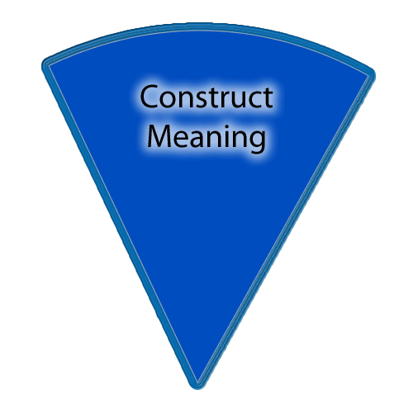
What is the difference between ‘promotion’ and ‘development’?
What do NGBs do to promote and develop athletes?
Explain your answers.

Slide 23
Exam question

Slide 24
How do NGBs impact sports participation
Notes:
https://www.youtube.com/watch?v=hNfcTx8H51U

Slide 25
Progress Indicators
PLANNERS OUT!
 | Good Progress | Outstanding Progress
Group 1 | To understand how NGBs improve the infrastructure of a sport. | To be able to analyse how NGBs improve the infrastructure of a sport. To understand how a NGB assists with policies and initiative of a sport.
Group 2 | To be able to explain how NGBs create tournaments and disciplinary procedures. | To be able to explain how NGBs promote etiquette and fair play in sport along with other policies and initiatives.
Accelerated Learning | Assessment for Learning | Collaborative Learning | Effective use of ICT | Thinking for Learning

Slide 26
How do NGBs distribute funding to sports?
Facts:
To receive funding for the NGB it has to agree to the "Whole sport plan".
To qualify for the whole sport plan funding you have to be able to show Sport England a four year plan showing how your sport intends to achieve key objectives in terms of increasing participation and success at the elite level.
In 2006-2007 Sport England invested £64,045,589 into 30 NGB whole sport plans.

Slide 27
Funding fill out the missing words
NGB’s are responsible for raising money to ensure there sport runs smoothly. This money is then distributed out to clubs e.g.; G_ _ _ _s M_ _ _ _ _ _ _ _ _s Subscription and M_ _ _h F_ _s L_ _ _ _ _y funding Income from m_ _ _ _M_ _ _ _ _ _ _ _ _ _ _ g

Slide 28
answers
Grants
Memberships
Subscription and Match Fees
Lottery funding
Income from media
Merchandising

Slide 29
What issues do NGBs face with funding?
https://www.youtube.com/watch?v=PinMHCRun2k
Make notes using the handout provided

Slide 30
plenary
Choose a colour / topic to answer:
What is a NGB? | What are NGBs used for? | Describe 2 sports and their NGBs
What is the level of investment required for a NGB? | Are NGBs good for sport? | What is ‘development’ and ‘promotion’ analysed in a NGB?
Identify 2 things you have found out about NGBs today. | What else do NGBs do? | Explain what you have learnt today.

