Slide 1
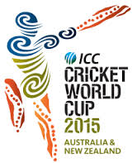
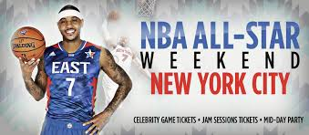
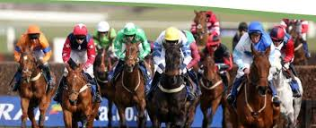
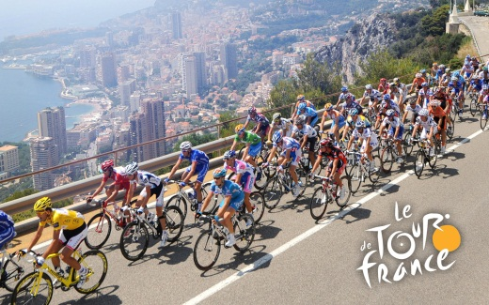
How many did you get?

Slide 2
Word consciousness
Something left or handed down by a predecessor
Ethical issue. A problem or situation that requires a person or organization to choose between alternatives that must be evaluated as right (ethical) or wrong (unethical).

Slide 3
L03
TBAT identify the differences between different sporting events.
TBAT understanding the importance of hosting major sporting events.
TBAT evaluate the differences between the draw backs and benefits of hosting a major sporting event.

Slide 4
LO3 Hosting Major Sports Events
Higher level officials required
Usually involves a bidding process
Generates significant media coverage
Potential legacy effect if a major
event such as Olympic games
or Football World Cup
Can attract other investment
Can be one-off regular or regular and recurring
(usually) Involves competitors from different countries
(usually) Involves spectators from more than one country
Regular
A major sporting event that happens annually which a city could host more than once in a relatively short period of time but is shared around as a rule.
Regular and Recurring
A major sporting event that happens annually and is in the same city/country for a long period of time.
One off
A major sporting event that will only happen in any given country/city once in a generation.

Slide 5
Three types of sporting events
One off
An event that will only be hosted by a country once in a generation.
i.e. World Cup, Olympic Games, Paralympics, World Athletics Championship
Regular
An annual event which a city can host twice in a short period of time.
i.e. Champions league
Regular and recurring
An annual event that is contracted for a period of years.
i.e. FA Cup, Wimbledon & Formula One

Slide 6
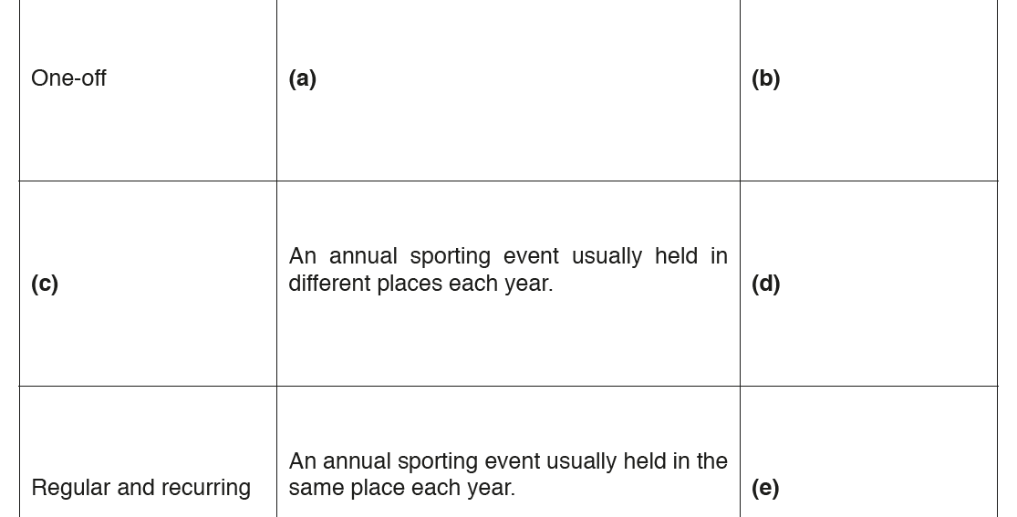
DNA
Regular

Slide 7
21. Name all the factors which impact on the popularity of a sport
18. Using an example, what is meant by spectator etiquette?
9. Name the 9 different user groups
24. Discuss the reasons why drugs are taken and why they shouldn’t be taken by performers.
12. Give an example of how an initiative has been used to promote values through sport.
4. What are the Olympic and Paralympic values?
1. Describe the 8 possible barriers which affect participation in sport.
6. Give an example of a possible solution linked to provision.
7. Describe the 5 features of a major sporting event
14. Give an example of a possible solution linked to promotion.
16. Give an example a growing/emerging sport in the UK
17. Why should you show etiquette before and during a game?
11. What are the 6 roles of National Governing Body. (NGB)
23. Recall the Olympic creed and explain what the symbol represents.
22.Define gamesmanship using an sporting example.
10. Define sportsmanship using an sporting example
13. Give examples from each role of the NGB
8. What are the 7 Values which are promoted through sport.
15. Describe the ethical issues for drug taking in sport.
19 Suggest an initiative introduced to break down barriers.
2. Suggest 3 major positives of hosting a major sporting event
20. Suggest 3 drawbacks of hosting a major sporting event.
5. What does WADA stand for and what do they do?
3. Give an example of a possible solution linked to access.

Slide 8
NAME 6 SPORTING EVENTS?
What are the regularity of each event?

Slide 9
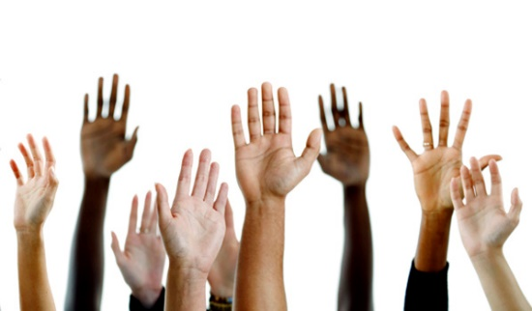
What is the difference between a ‘one off’ & ‘regular’ event?
Explain why and add examples of major sporting events.
What is a ‘regular and reoccurring’ event?

Slide 10
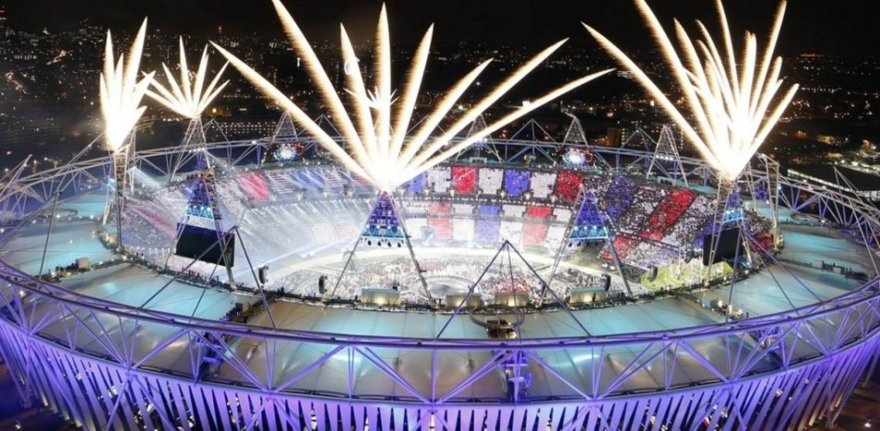
The Importance of hosting major sporting events
https://www.youtube.com/watch?v=4As0e4de-rI
Notes:
https://www.youtube.com/watch?v=hNfcTx8H51U

Slide 11
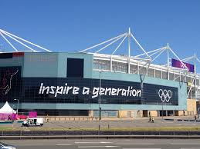
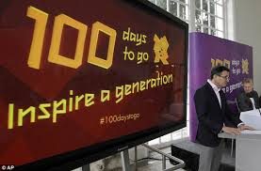
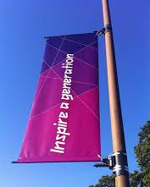
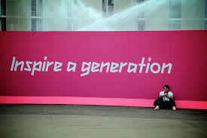
Potential Legacy
Host nationals aim to use sporting events to create a type of legacy:
Sporting
Inspire others to take part in sport (participation)
Role models created
Training development increases
The profile of sport is raised (women and minority sports)
Economic
Use the money to stabilise the country.
Helping local businesses
Increases tourism
UK investment
Investment in infrastructure
New jobs
Social
Increase the moral of a nation.
Feel good factor

Slide 12
Level of investment
Both needed/required to be attracted.
How can major sporting events get money?
Major sporting events attract sponsors to help with the costs and publicise their company.
The cost to bid for an event is high, if you then get to host that event the cost becomes even higher.
e.g. London 2012 Olympics
Bid = £17 Million
Cost to build the stadiums, roads, rail links and athletes village = £9.35 Billion
Soaring costs and potential debt (Montreal, ‘76) – Games estimated to cost ~£20bn – 10 times more than originally estimated!

Slide 13
What do the Olympic rings represent?
They represents the five continents of the world, united by Olympism, while the six colours are those that appear on all the national flags of the world at the present time.

Slide 14
Exam Question (2016 Paper)
Q. 13
Give an example of an international sports event that occurs on an annual basis in the UK.
…………………………………………………………………………………………………………………………………………………(1)
Notes:
Tennis- Wimbledon / Formula One – British Grand Prix / Athletics Grand Prix – Crystal Palace

Slide 15
Do it now task!
Discuss with a partner and write down as many positive and negatives cities have when hosting major sporting events.
Positives | Negatives

Slide 16
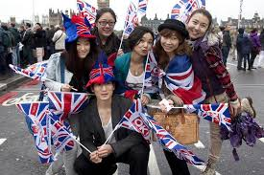
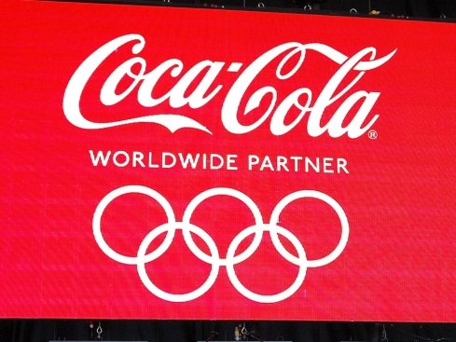
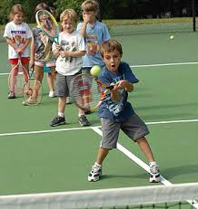
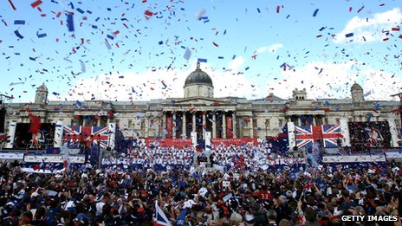
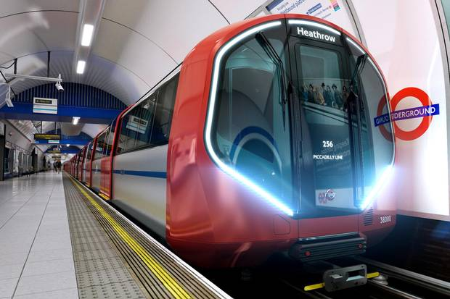
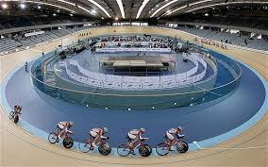
Benefits of hosting a major sporting event
Increased participation in sport.
Commercial benefits
i.e. sponsors & investments
Increased tourism
Moral of the country is raised- national pride
Investment in improving transport system.
New sporting facilities

Slide 17
Benefits and drawbacks of cities hosting major sporting events
Notes:
https://www.youtube.com/watch?v=hNfcTx8H51U

Slide 18
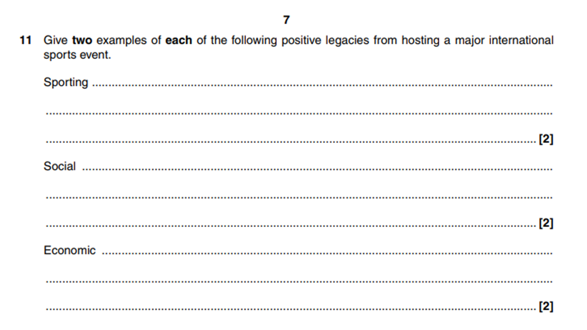
Sporting
Inspire others to take part in sport (participation)
Role models created
Training development increases
The profile of sport is raised (women and minority sports)
Economic
Use the money to stabilise the country.
Helping local businesses
Increases tourism
UK investment
Investment in infrastructure
New jobs
Social
Increase the moral of a nation.
Feel good factor
Mark you exam question using green pen.

Slide 19
Exam question (2016 paper)

Slide 20
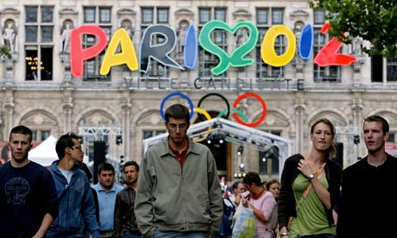
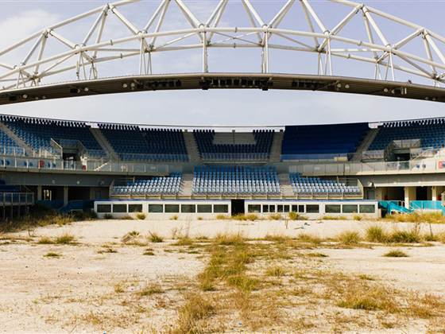
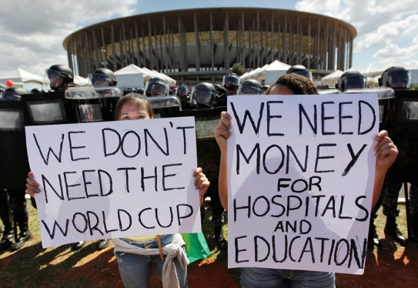
Negatives of hosting a major sporting event
Bidding to host can be expensive and you may not win.
The event can cost more than the money raised
Facilities can end up not being used after the event.
Can have a negative effect on the country if the event is not run properly.
https://www.youtube.com/watch?v=CEqhwlFiF5E

Slide 21
Draw backs of hosting a major sporting event
Soaring costs and potential debt (Montreal, ‘76) – Games estimated to cost ~£20bn – 10 times more than originally estimated!
Rising council tax bills for local people.
Lack of long-term job opportunities.
Increased housing/rental prices – discriminates against local people.
Focus on elitism rather than participation - Paula Radcliffe.
While hosting the event will help to promote one area of sport, others may suffer as a consequence
Other regional areas experiencing limited/no direct benefits.
Emphasis on Nationalism – result in discrimination.
Facilities can end up not being used after the event if not planned properly
Can have negative impact on the status of the country if event runs poorly/is disorganised

Slide 22
Do the benefits outweigh the drawbacks?

Slide 23
Choose a colour / topic to answer:
Describe what the international element is. | What is an Olympic legacy? | Explain the benefits of an Olympic games for a city.
What is the level of investment required for an Olympic games? | Will an Olympic games attract good investment and why/how? | Give an example of how an Olympic games has created a legacy.
What 3 things form a potential legacy? | What's a drawback of an Olympic games? | Could any city host an Olympic games and why?
Difficulty:
BLUE RED PURPLE GREEN YELLOW
HOMEWORK: Revise the history of Olympic Games and their potential legacies.
Notes:
Reviewing is a critical element in the process of teaching and learning as it is at this point that teachers can challenge the students to make their learning explicit. Although Review is the last of the elements of the cycle to be described, it should not be seen as coming only at the end of a lesson. It is useful to include different review opportunities throughout every lesson so that teachers and students can identify challenges and supports, and strengths and weaknesses. Review is a significant part of developing metacognitive awareness.

Slide 24
plenary
Explain the difference between a 'on-off' sporting event and a 'regular' sporting event.
Share and analyse with sporting examples with a partner.
Create a mind map of what you have found.

Slide 25
London 2012 Olympic legacy
What's London 2012s Olympic legacy?
What does it mean to you?
What's London 2012s Olympic motto?
Is this motto being interpreted in the UK?

Slide 26
Name 4 positives of hosting a sporting event?
Why?

Slide 27
Name 4 negatives of hosting a sporting event?

Slide 28
Exam Question (2016 Paper)
Q. 12
Describe three possible negative impacts on a host city after an international sporting event.
…………………………………………………………………………………………………………………………………………………(6)
Notes:
Tennis- Wimbledon / Formula One – British Grand Prix / Athletics Grand Prix – Crystal Palace

Slide 29
Exam Question (2017 Paper)
Q. 13
Describe three possible positive impacts on a host city after an international sporting event.
…………………………………………………………………………………………………………………………………………………(6)
Notes:
Tennis- Wimbledon / Formula One – British Grand Prix / Athletics Grand Prix – Crystal Palace

Slide 30
Benefits of countries hosting major sporting events
investment in developing/improving transport system
– increased direct and indirect tourism
– commercial benefits (e.g. money from sponsors, external investment which would not otherwise have been attracted)
– participation may increase in some sports
– infrastructure/social facilities built can be used by people who live in the area where the events have been held
– sports facilities will be improved or new facilities built
– raise the status of the country/‘shop window effect’
– morale of the country is raised

Slide 31
drawbacks of countries hosting major sporting events
bidding to host can be expensive and you may not be awarded the event
– event can cost hosts more than it raises in revenue
– facilities can end up not being used after the event if not planned properly
– can have negative impact on the status of the country if event runs poorly/is disorganised
– while hosting the event will help to promote one area of sport, others may suffer as a consequence
– can cause divisions in the country if the specific area which hosted (e.g. one city) is perceived to have been the only beneficiary.

